Slide 1
Hotel Reservation Analysis with SQL
Harsha Lal

Slide 2
Problem Statement
The hotel industry relies on data to make informed decisions and provide a better guest experience. Work with a hotel reservation dataset to gain insights into guest preferences, booking trends, and other key factors that impact the hotel's operations. You will use SQL to query and analyze the data, as well as answer specific questions about the dataset.

Slide 3
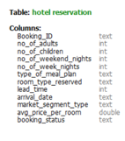
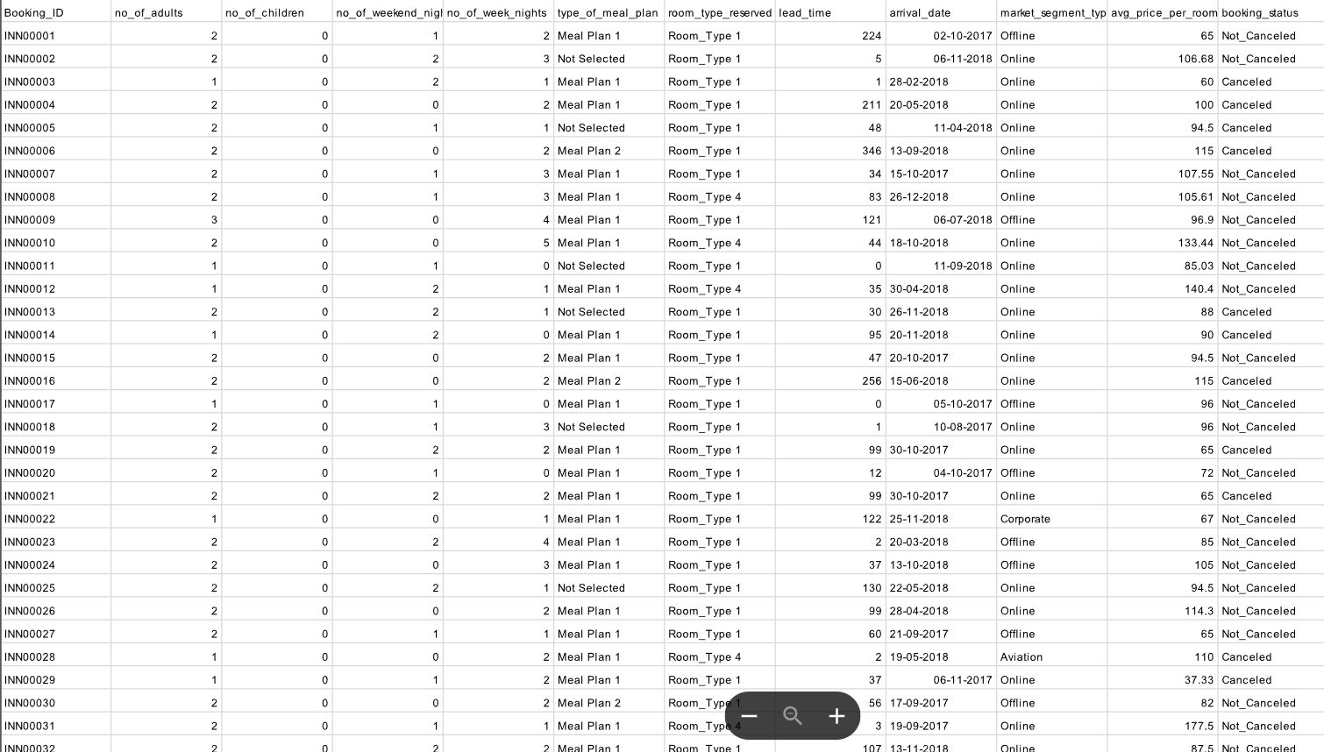
Dataset

Slide 4
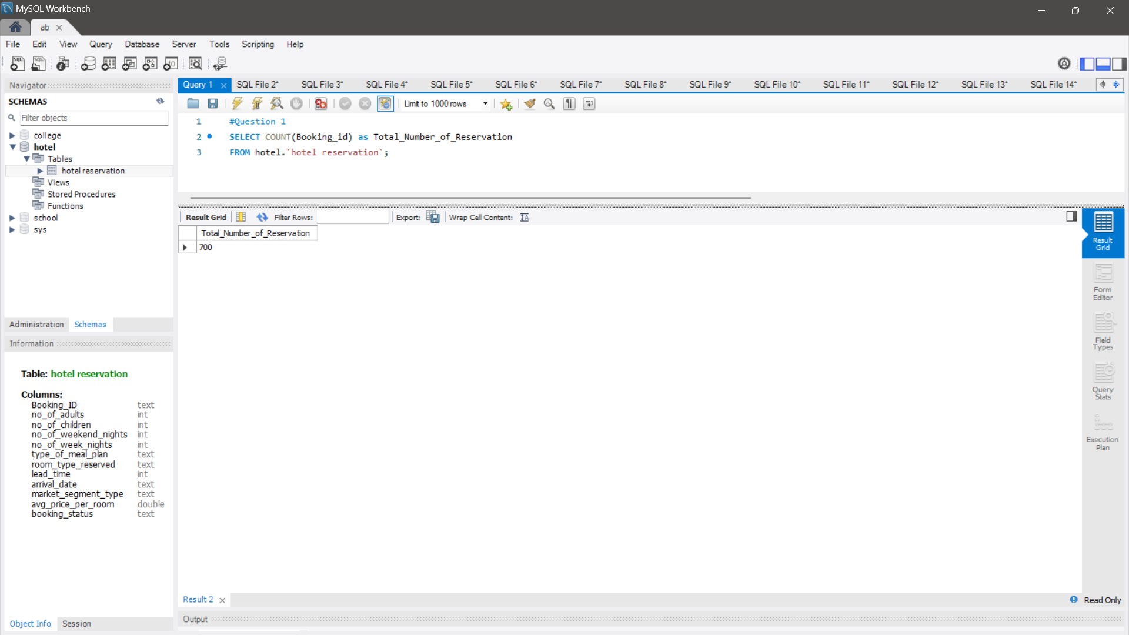
What is the total number of reservations in the dataset?

Slide 5
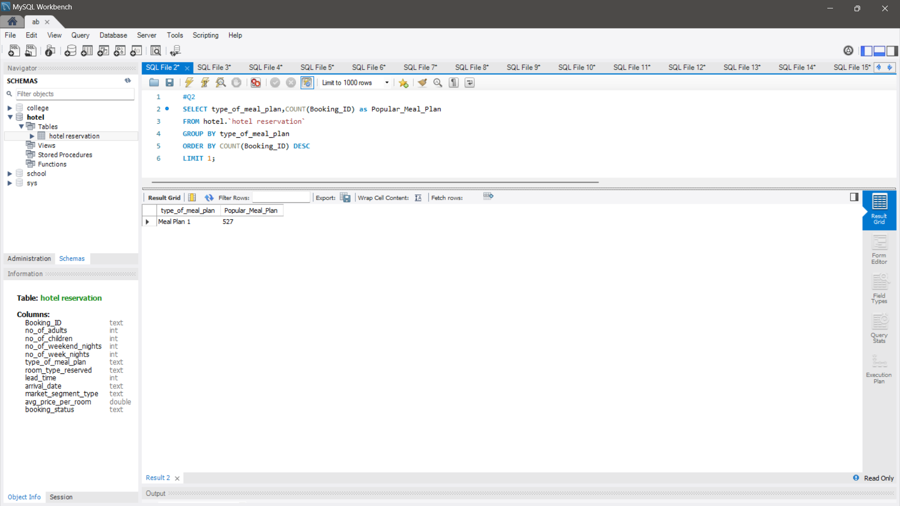
Which meal plan is the most popular among guests?

Slide 6
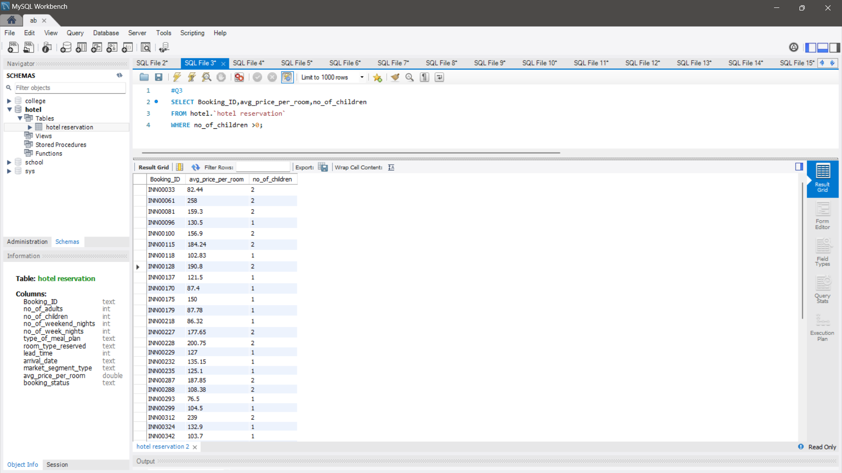
What is the average price per room for reservations involving children?

Slide 7
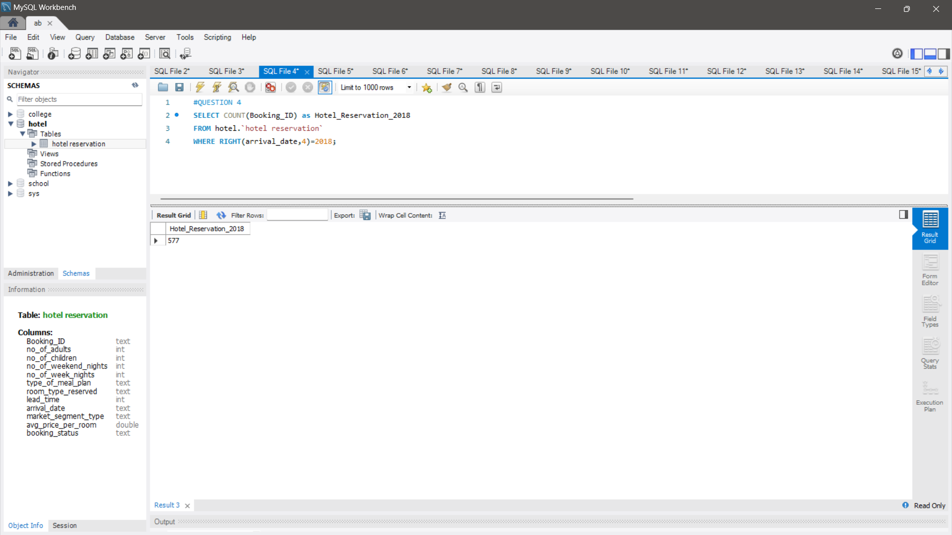
How many reservations were made for the year 20XX (replace XX with the desired year)?

Slide 8
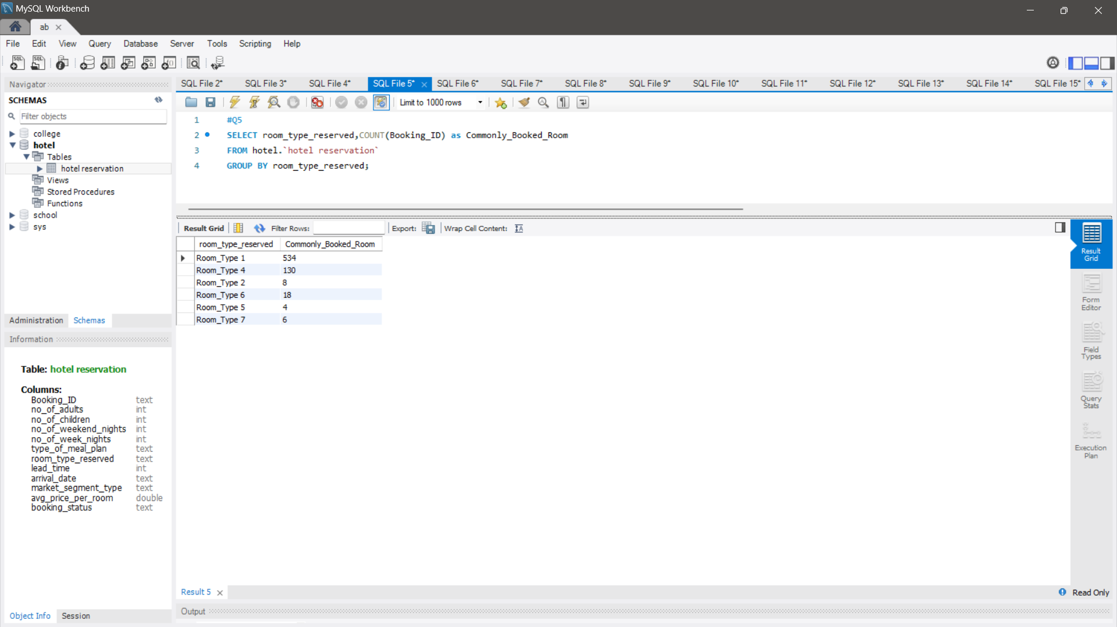
What is the most commonly booked room type?

Slide 9
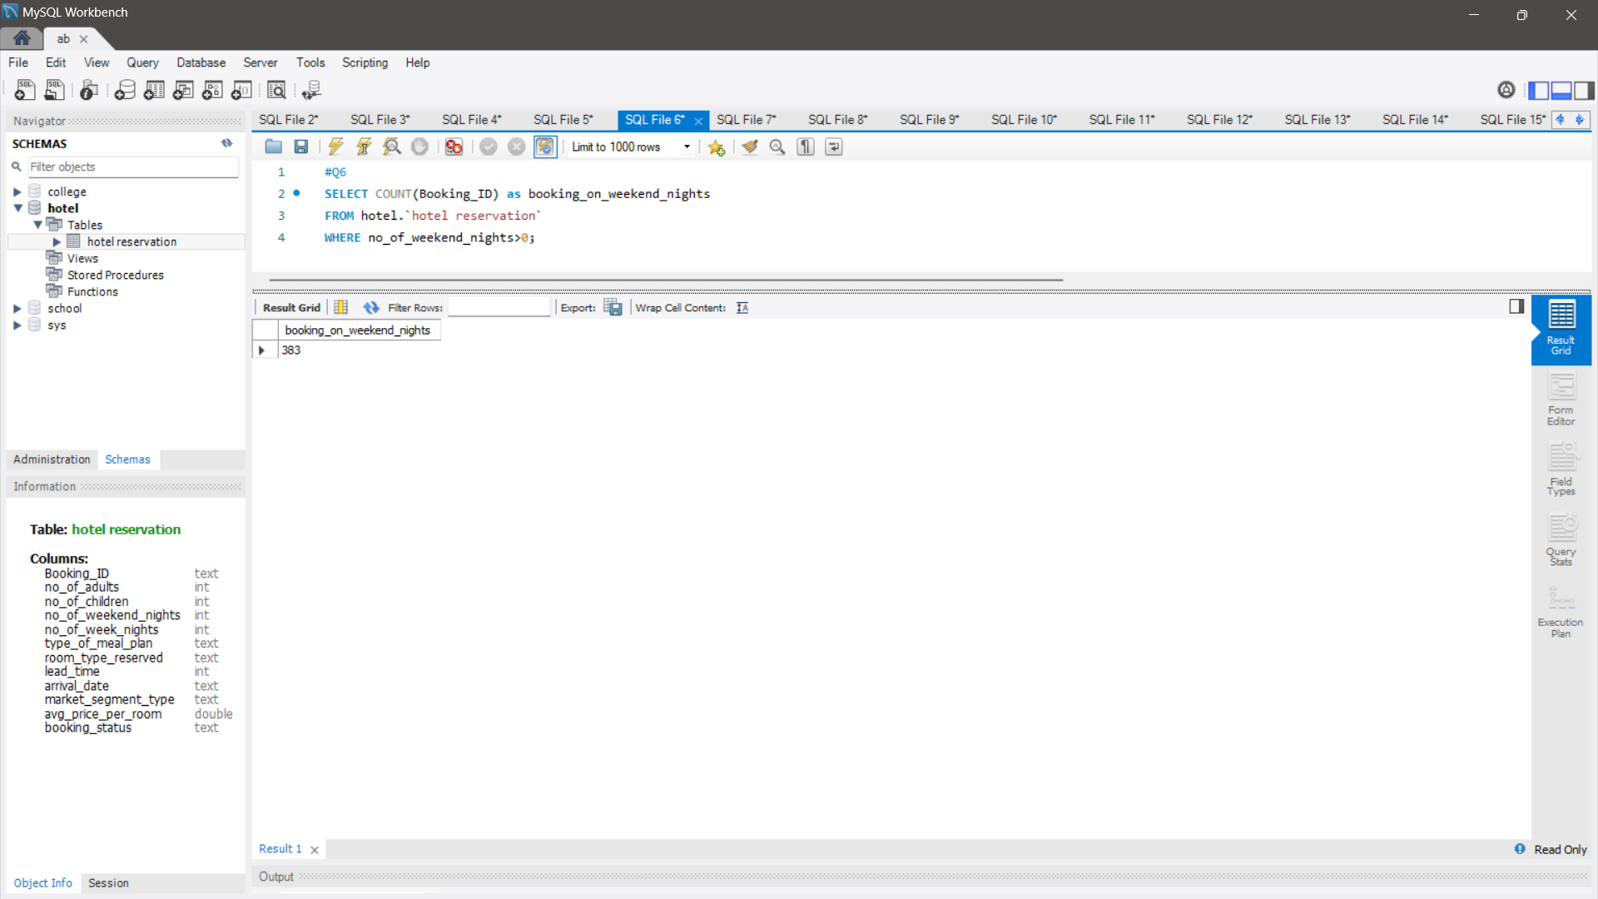
How many reservations fall on a weekend (no_of_weekend_nights > 0)?

Slide 10
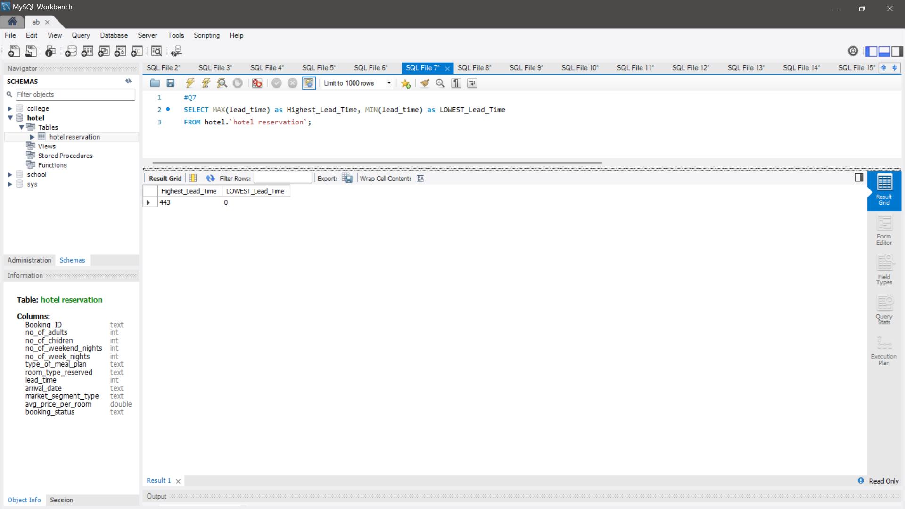
What is the highest and lowest lead time for reservations?
At Contoso, we empower organizations to foster collaborative thinking to further drive workplace innovation. By closing the loop and leveraging agile frameworks, we help business grow organically and foster a consumer first mindset.

Slide 11
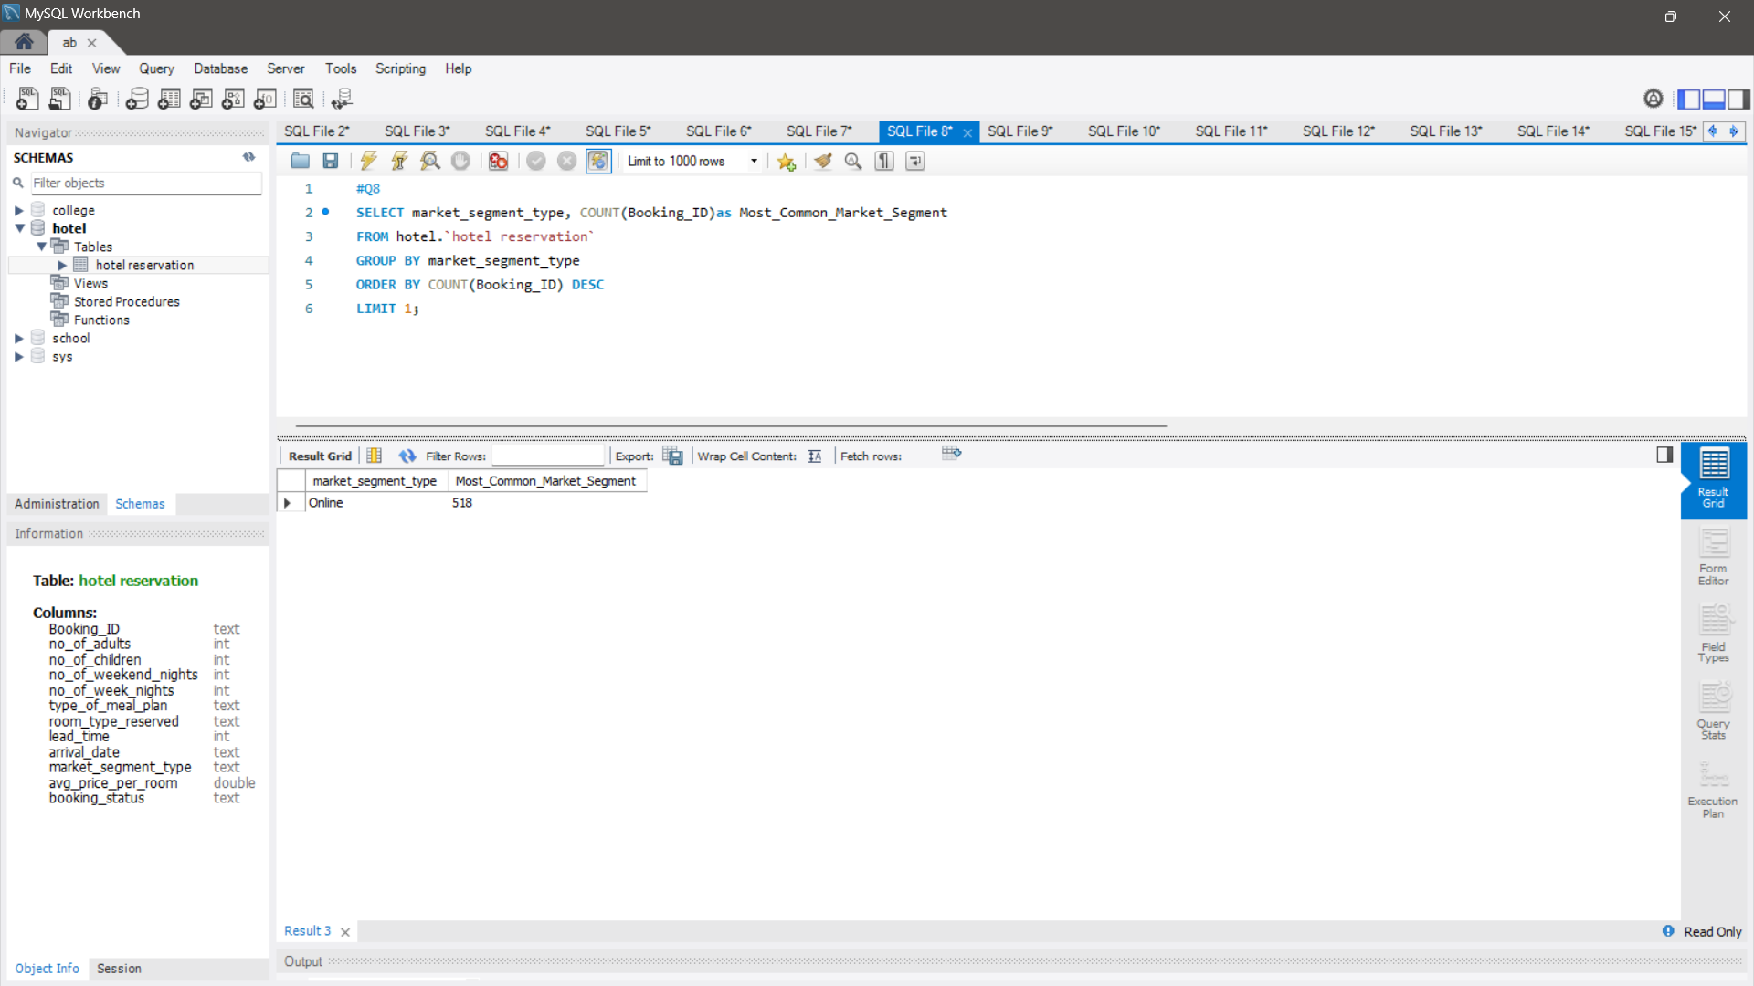
What is the most common market segment type for reservations?
At Contoso, we empower organizations to foster collaborative thinking to further drive workplace innovation. By closing the loop and leveraging agile frameworks, we help business grow organically and foster a consumer first mindset.

Slide 12
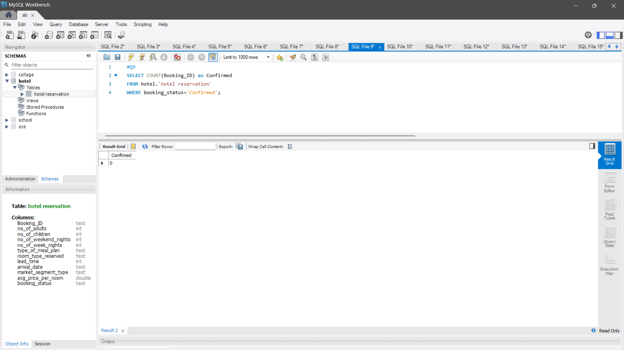
How many reservations have a booking status of "Confirmed"?
At Contoso, we empower organizations to foster collaborative thinking to further drive workplace innovation. By closing the loop and leveraging agile frameworks, we help business grow organically and foster a consumer first mindset.

Slide 13
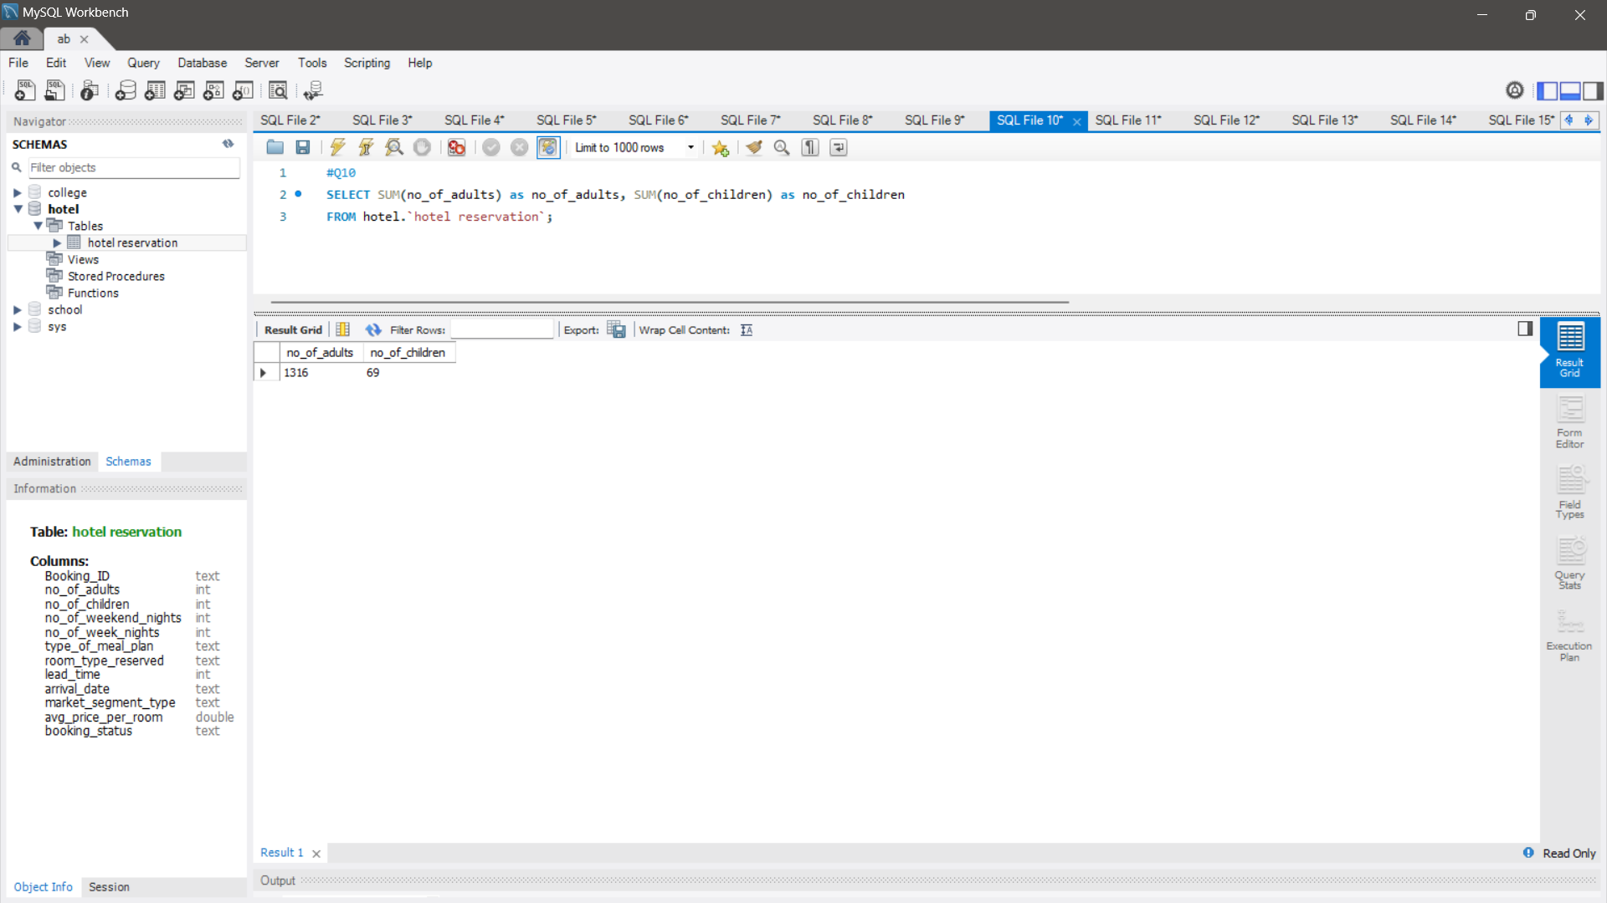
What is the total number of adults and children across all reservations?
At Contoso, we empower organizations to foster collaborative thinking to further drive workplace innovation. By closing the loop and leveraging agile frameworks, we help business grow organically and foster a consumer first mindset.

Slide 14
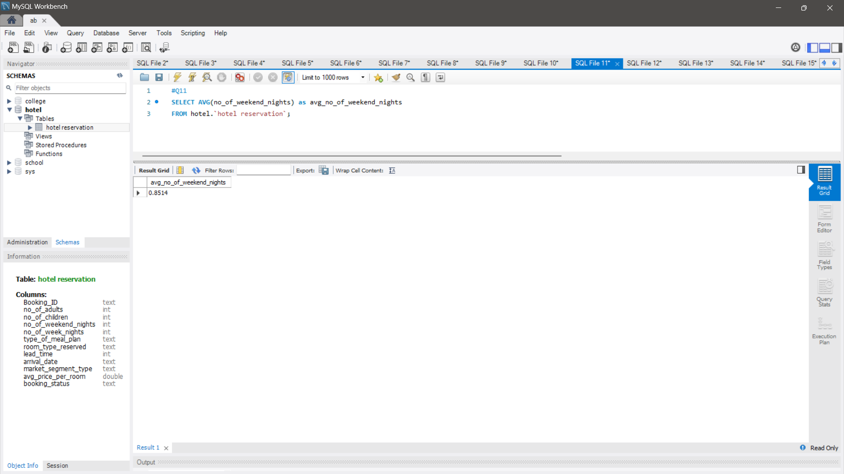
What is the average number of weekend nights for reservations involving children?
At Contoso, we empower organizations to foster collaborative thinking to further drive workplace innovation. By closing the loop and leveraging agile frameworks, we help business grow organically and foster a consumer first mindset.

Slide 15
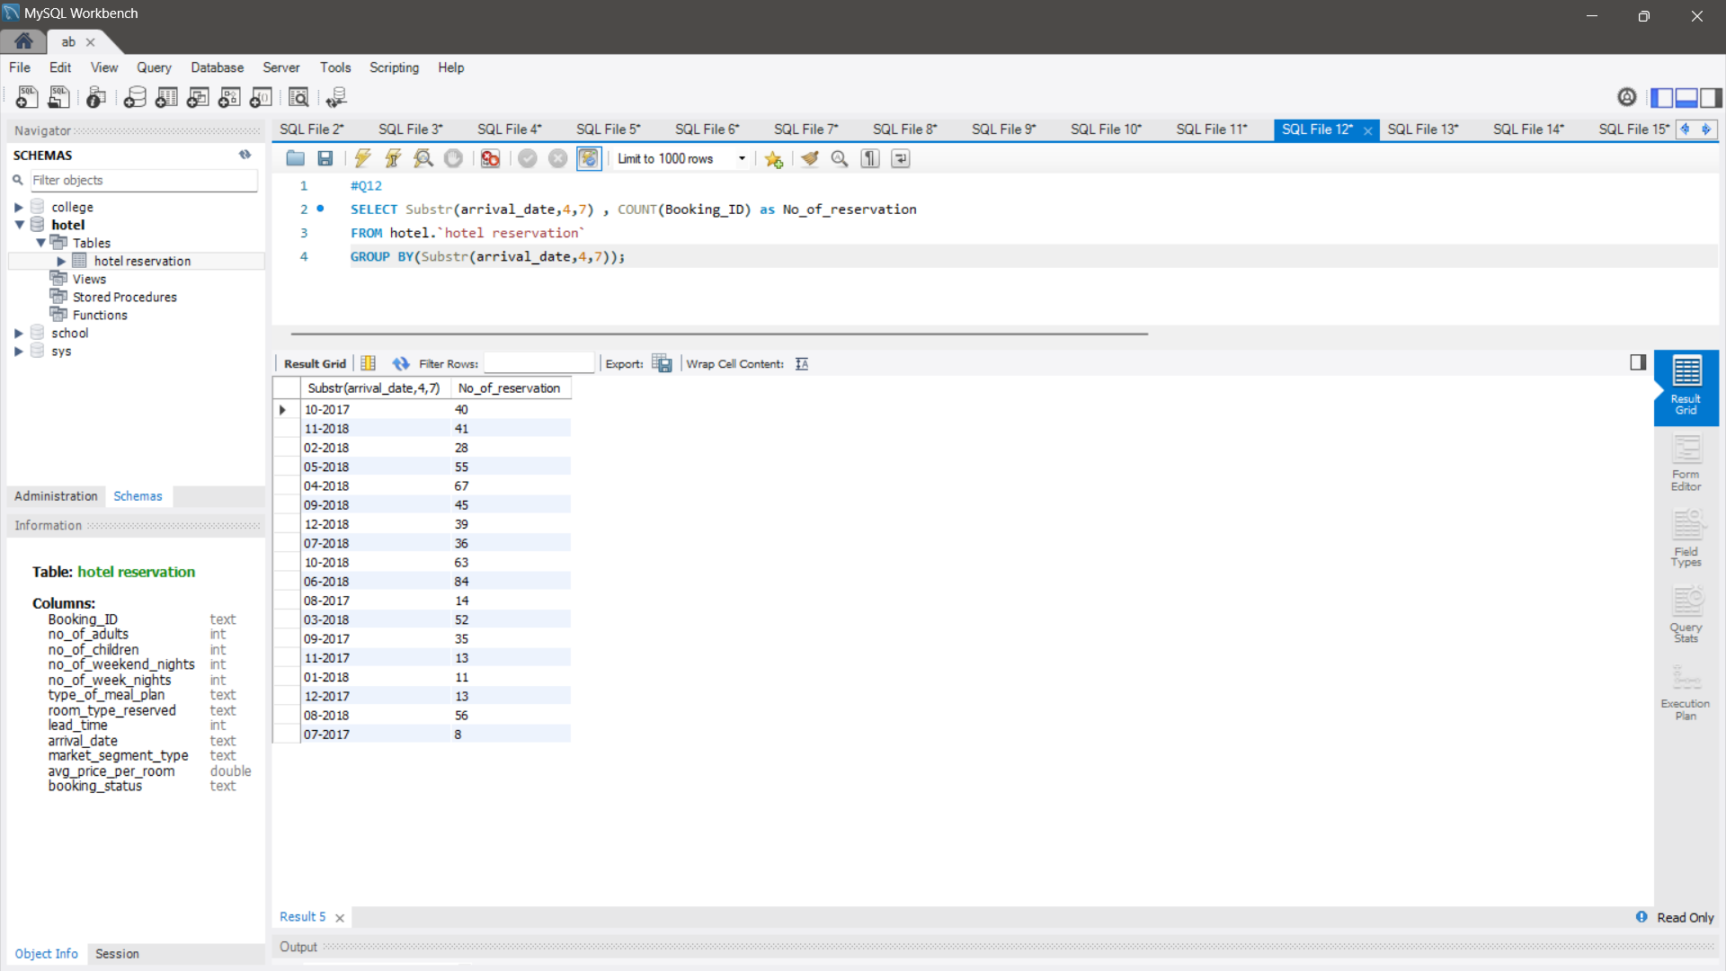
How many reservations were made in each month of the year?
At Contoso, we empower organizations to foster collaborative thinking to further drive workplace innovation. By closing the loop and leveraging agile frameworks, we help business grow organically and foster a consumer first mindset.

Slide 16
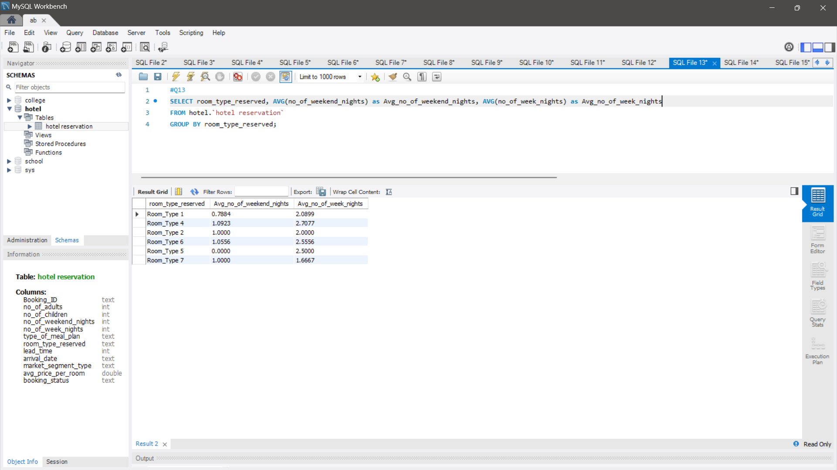
What is the average number of nights (both weekend and weekday) spent by guests for each room type?
At Contoso, we empower organizations to foster collaborative thinking to further drive workplace innovation. By closing the loop and leveraging agile frameworks, we help business grow organically and foster a consumer first mindset.

Slide 17
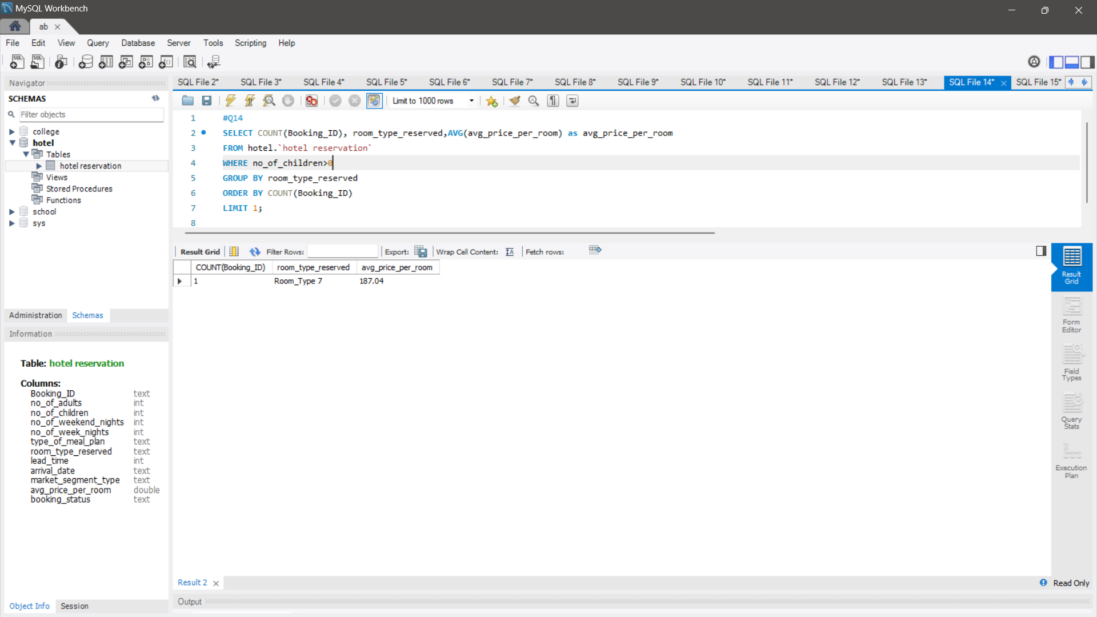
For reservations involving children, what is the most common room type, and what is the average price for that room type?
At Contoso, we empower organizations to foster collaborative thinking to further drive workplace innovation. By closing the loop and leveraging agile frameworks, we help business grow organically and foster a consumer first mindset.

Slide 18
Find the market segment type that generates the highest average price per room.
At Contoso, we empower organizations to foster collaborative thinking to further drive workplace innovation. By closing the loop and leveraging agile frameworks, we help business grow organically and foster a consumer first mindset.

Slide 19
Thank you

